Slide 1







IOT WORKLOAD CHARACTERIZATION IN NEXT GENERATION CLOUD SYSTEMS UPDATE
Supervised by: Dr. Karan Mitra, Dr. Saguna Saguna,
Dr. Christer Åhlund
Presented by: Fatema Mirza

Slide 2






Latest additions
TABLE OF CONTENTS
fatmir-0@student.ltu.se

Slide 3
01
Latest additions
fatmir-0@student.ltu.se

Slide 4
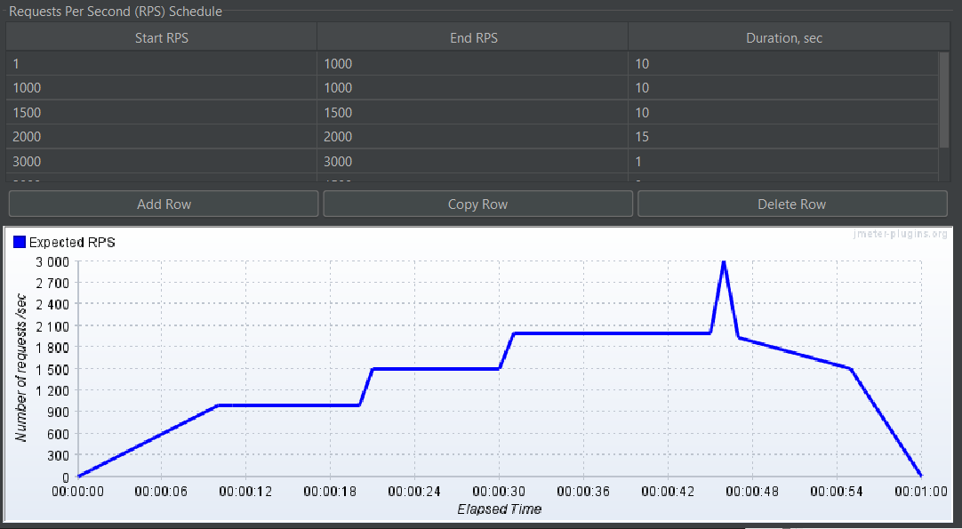
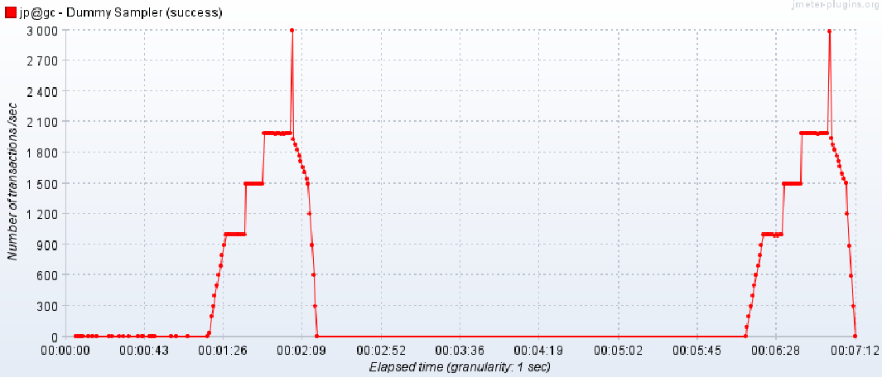
Jmeter Custom Load Generate
Thanks to the authors of A Hybrid Mechanism of Horizontal Auto-scaling Based on Thresholds and Time Series who replied to my frantic emails, I figured out how to custom load generate. The graphs below is only for demonstration purpose.
Load specified
Load successfully generated (twice)

Slide 5
Options …
Load could be generated using Jmeter and specifying the requests per seconds. (The idea is taken from the paper A Hybrid Mechanism of Horizontal Auto-scaling Based on Thresholds and Time Series)
The base value for each 15 minute of simulation will be obtained from the corresponding 15 minute in the workload traces. This value will be divided by 15 to define the base number of average requests per minute for that 15 minute. Within each 15 minute, requests that will be submitted at each minute, following a Poisson distribution using the base number of requests/min for the 15 minute as the average. Each request is modeled to require 50 ms with a positive variation of 10%, uniformly distributed. (The idea is taken from the paper Workload Prediction Using ARIMA Model and Its Impact on Cloud Applications’ QoS)

Slide 6
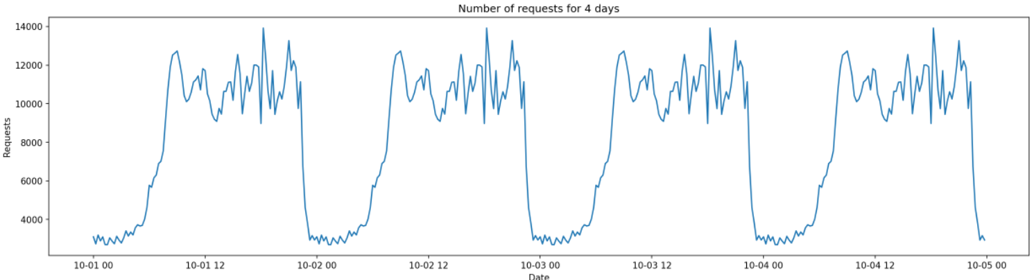
ARIMA or SARIMAX?
Dataset for 4 days where 3 days will be used as training and the 4th day will be used as testing.

Slide 7
ARIMA or SARIMAX?
ARIMA gives good results, but with changing the dataset as such for 4 days, a seasonality is added (repeats every day) which helps in prediction even further, especially with sliding window of 1 hour.

Slide 8
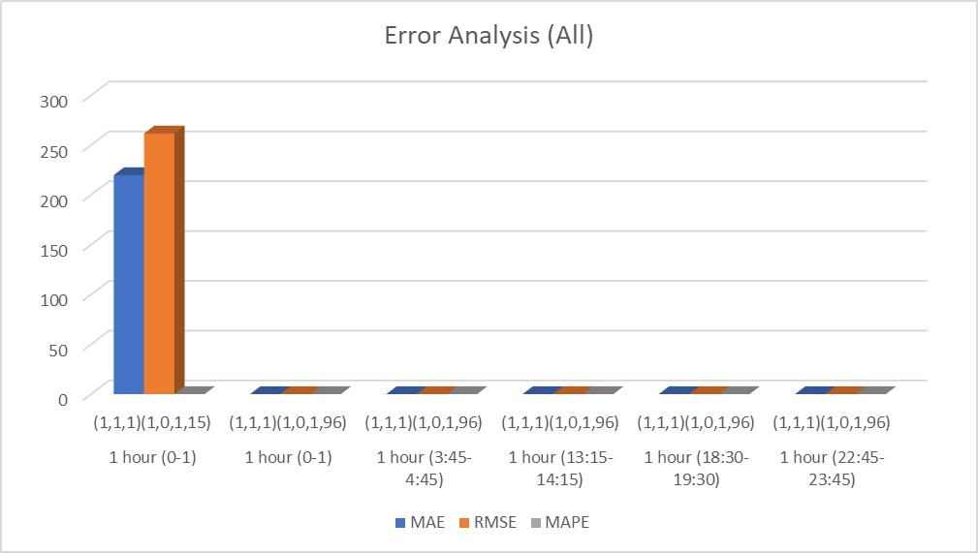
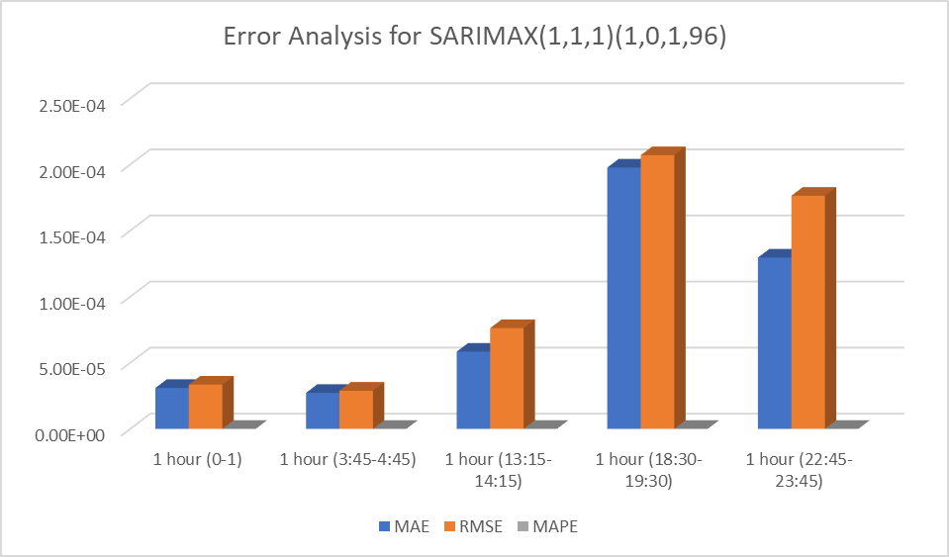
ARIMA or SARIMAX?

Slide 9
Simplified Idea
1. Create a program on an EC2 instance named LBServer which will contain the program that will predict the upcoming workload for 1 hour
2. Based on a threshold (set upon using experiment), if the predicted workload is above a certain level, this will trigger the instantiation of a new instance 30 minutes before it is required. Based on the size of the workload, different types of instances can be selected.
3. Based on a threshold (set upon using experiment), if the predicted workload is below a certain level, this will trigger the instantiation of a new instance 30 minutes after it is required.
4. Set up either AWS autoscaling algorithm or round robin algorithm to compare the proposed algorithm

Slide 10
Challenges
What sort of metric will be measured? A solution could be to measure the response time write requests to a file.
2. How to set the threshold? A solution could be to experiment with Jmeter data.
3. How to instantiate and route traffic on AWS? This has to be done using the AWS java sdk and possibly with HAProxy.
Will have to create a back up in CloudSim, just in case.

Slide 11

Thank you! Tack så mycket
Any Questions?
fatmir-0@student.ltu.se

